Slide 1
Notes, abstract
Put Dev-Ops into perspective.
As a DBA or Database-person you will be asked to join a Dev_Ops team and use some of the Agile methods. When this happens, you will have to absorb new knowledge and work-habits. But you will also have to educate your colleagues on what is possible and impossible at the database level.
We will try to give some guidelines, and point out a few embarrassing mistakes we made in these situations.
Level: All
Time: anywhere from 30 to 60 min.
Repeat of history, with different naming convention.

Slide 2



Dinosaur DBA versus and Dev Ops
Piet de Visser
The Simple Oracle DBA
Favorite Quotes: “The Limitation shows the master” (Goethe), “Simplicity is not a luxury, it is a necessity. Unfortunately, “Complex’ solutions sell better. (EW Dijkstra).

Slide 3













Logo Cloud
Shell
Philips
ING bank
Nokia
(dutch gov)
Insinger, BNP
Etihad
NHS
BT
Claritas, Nielsen
Unilever
Exxon
GE
Don’t waste time on Self-Inflation… but Hey, this was such a cool Idea (from a marketing guy)…
Logos of my major customers over time. If you want your logo here: Hire me.

Slide 4
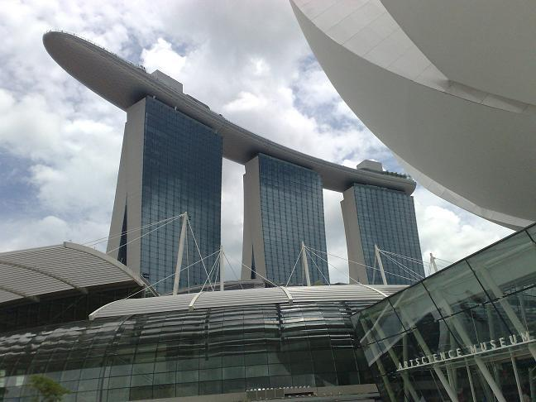
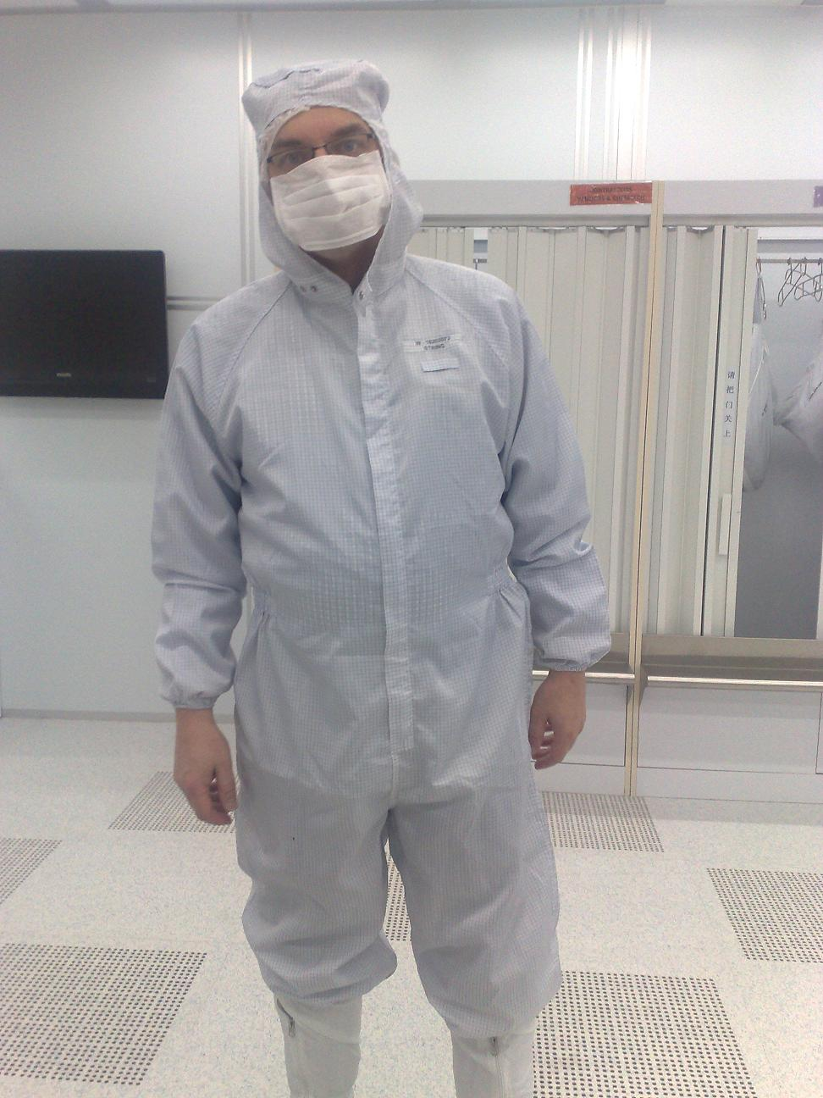
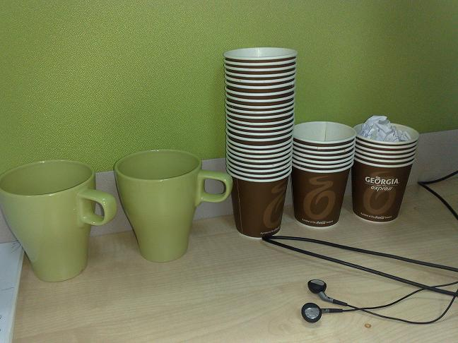
What does it look like..
Couldn’t resist… after this changing room, not allowed to take pictures anymore..
For travel pictures from Asia: later…

Slide 5
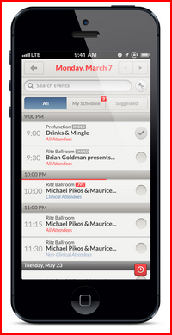
Agenda (approx 45 min)
History… 80s, 90s, 00s… (old stuff…)
Our History (What we did)
DevOps (New!)
Jargon (buzzwords)
Lessons ?
10 min Discussion (Do Challenge!)
Agenda: What is going to happen 1-in this talk and 2-to your job.
20+ slides, 2min/slide.

Slide 6
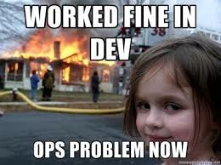

What is happening …
Users:
Need more, need it Faster..,
But also need Working system, Stability
Dev-teams:
Must Deliver
Wants to use latest tools …
Be Agile!
Operations (DBA?)
Too much changes..
System not stable.
Architect:
We Need Standards
Must follow process ...
Image:
Clueless,
Pointing..
Depends on who you ask…
Large organisations are compartimentalized, Silos...

Slide 7

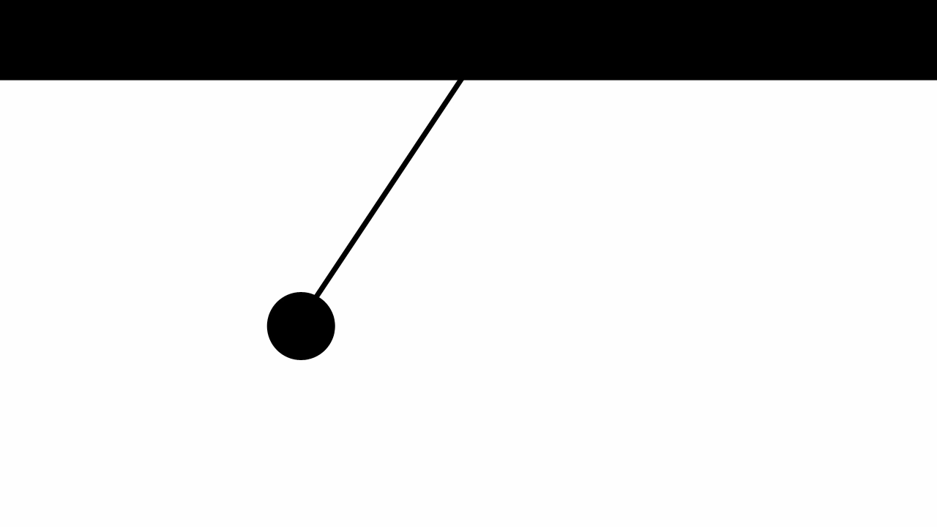
History (80s, 90s)
Mainframe (or Novell + PCs)
Small team of IT
Analysis, Design, Programming, Pager/Phone…
Did Everything.
Fixed Everyting.
Easy Communication.
Common Goal : Make things Work.
No managers.
In the 80s.. Short lines of communications.
Everything got fixed… And then the cycle started ....

Slide 8
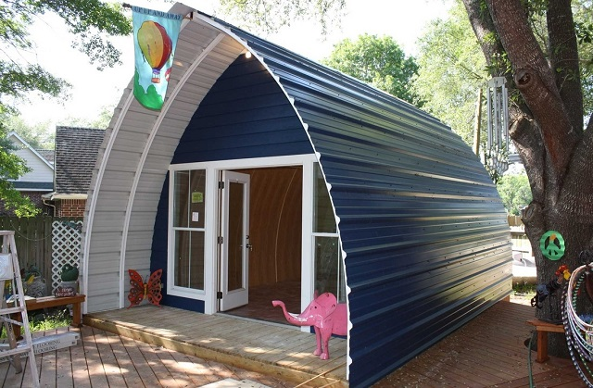
A “Plummer” can build…
A small house…
Maintain it..
Dev Ops.. “You Built IT, You Run IT”
But many small houses…
Overworked ?
I told my boss/client in 1997 or so: we need more planning, more “structure”, we need an architect??
I did not know what would go wrong…

Slide 9
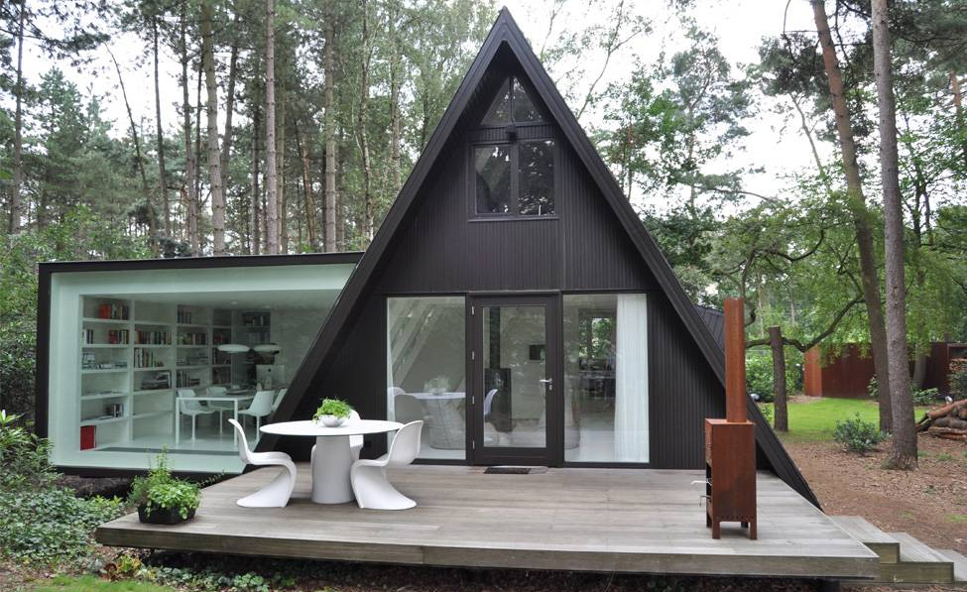

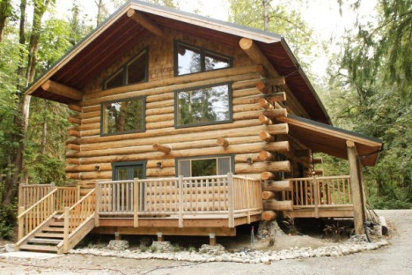

More + Complex houses…
But houses and systems become more complex This is what happened to some IT shops…
And then the plummer (team) becomes overwoked…

Slide 10

We need some “structure”
Regulation needed…
Architecture, structure…

Slide 11

Specializations … (90s)
Analysists …
Designers…
Programmers...
Testers....
DBA’s ...
System-Admins...
Storage-Admins...
+ Managers…
+ Managers…
+ Managers...
+ Managers...
+ Managers...
+ Managers...
+ M ....
Process… Specialization.. Outsourcing... Offshouring..
And this needs management…

Slide 12
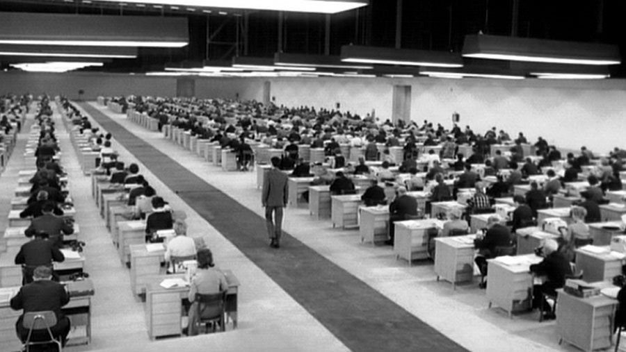
Kafka comes along…
Process, Procedures…
Specialization...
Outsourcing....
Off-shoring, Near-shoring...
Image:
keys
Process… Specialization.. Outsourcing... Offshouring.. Cobol Teams in India, QA-Process...
People Skills became less important, Proces!!

Slide 13

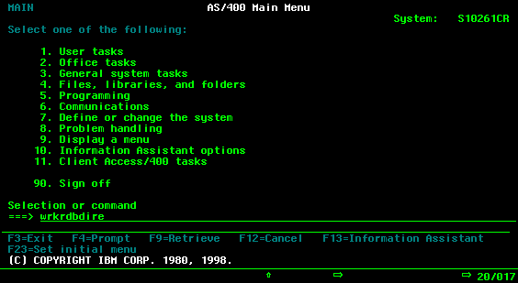
1997: the “Oracle Cowboy”
Replace...
Mainframe Maffia..
By “new tech”
Unix
Oracle
Windows (3.11, 95...)
Forms 3.0, Forms 4.5, Designer/Develooper
Small teams, Rapid Protytyping....
Users + Developers + DBA working Closely (again)
Flexible!
(DevOps?)
Image:
keys
We learned how to “eat the IDMS datasets, and run them on Oracle, Forms, Powerbuilder, and EBS…
Our finest moment: Replacing OTR and GL by EBS 10.7 - Yeah! (anyone remember the patching of EBS...)

Slide 14

But as “new” systems grow….
(you make some mistakes)
(interface anecdote… later)
Specializations appear
Architects
DBA.
Windows-Admins...
CM & QA processes …
Testing as a “discipline”
“We are CMMI level 5…”
Requirements + Process…
Managers ++
So by the time the “new tech” becomes important enough.. It becomes a bureaucracy…
SLA’s, Tickets, Outsource, … Offshore. …

Slide 15
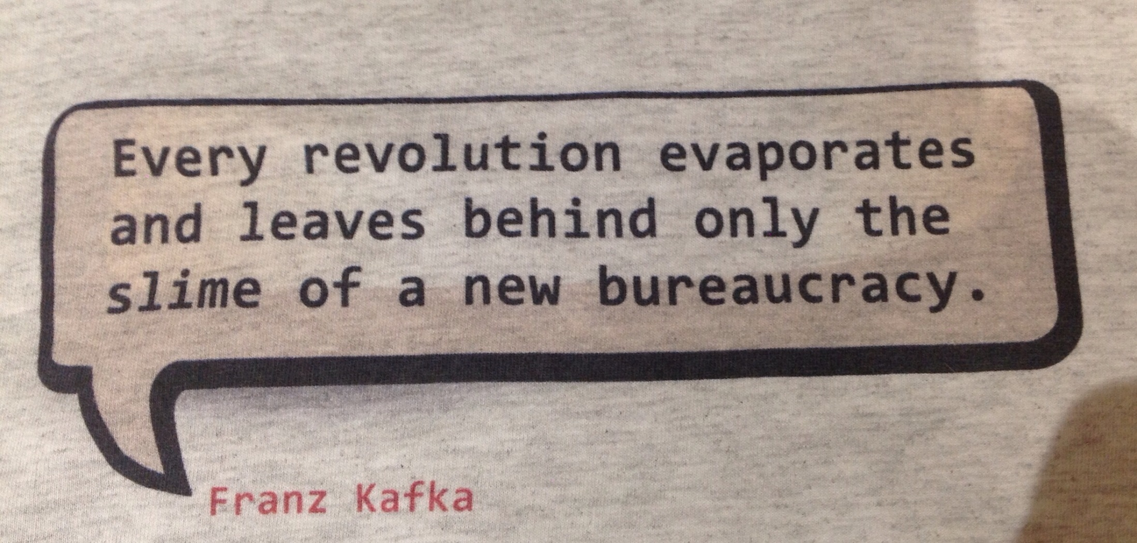
Again: Specialization…(new names)
Architects…
Process designers…
Requirments...
Testers....
Operations...
Network-Admins...
Security-Admins...
+ Managers…
+ Managers…
+ Managers...
+ Managers...
+ Managers...
+ Managers...
+ M ....
And guess what: Process… Specialization.. Outsourcing... Offshouring..
And this needs …. management…

Slide 16
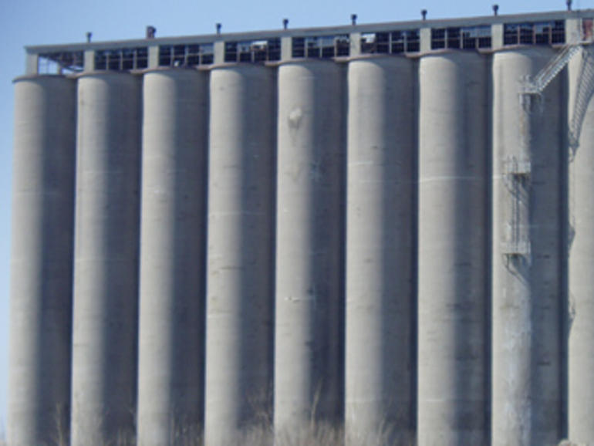
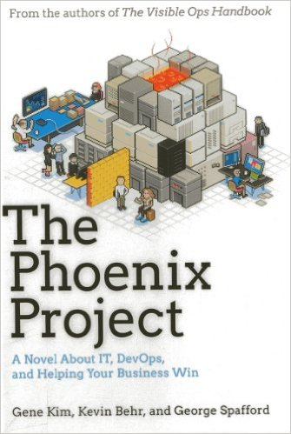
And now … Silos versus DEV-OPS
How the Dev-Ops “Cowboys” see the old ways…
Dev-Ops is about eliminating the Silo’s … again… And they have a point…
That book is a recommended Read.. If you have also read “the goal”, this is the next book...

Slide 17
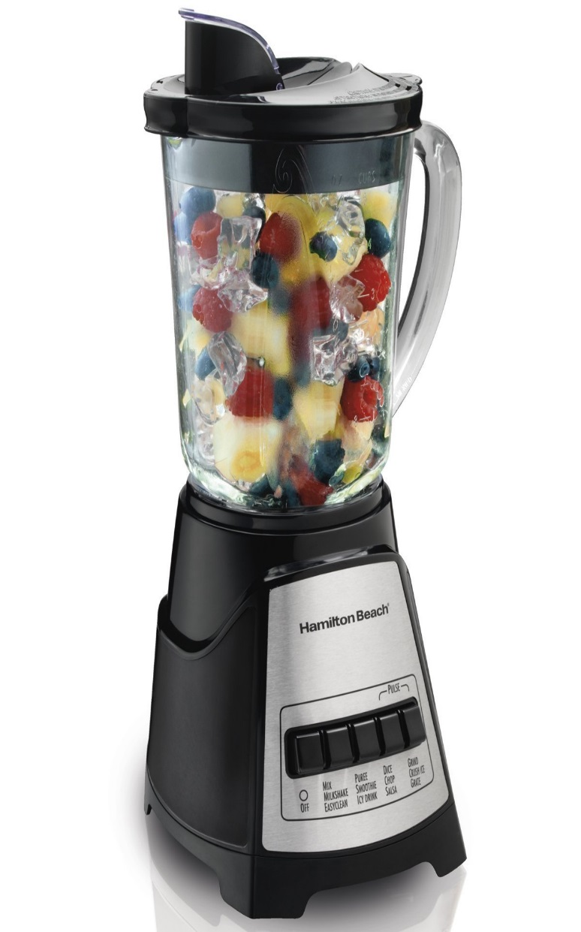
Dev-Ops: The 3 Ideas
Goal: Support the Business..
Sounds familiar ?
1. Collaboration
Multi-Disciplined team
Agile, Lean
Shared Responsabilities...
2. Automation
Fast turnaround (build, test, deploy)
Provisioning (cloud.. )
3. Continuous Delivery
Always ready to deploy
Dev-Ops (wikipedia states …. )
And they have a point…

Slide 18
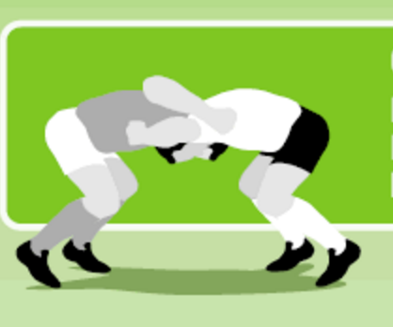
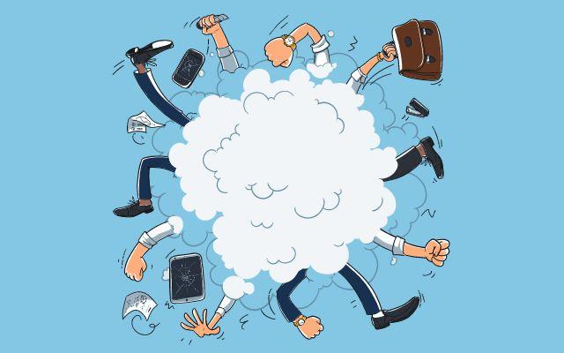
Dev-Ops: 1. Collaboration
Multi-Disciplined Teams
They seem to really mean it now...
Educate Eachother !
You must learn from team members
From Different Backgrounds...
Forget hobby-projects (+ forget managers)
Focus on Customer + Team-goals
Jargon: Scrum, Standup...
Burndown-chart,
Backlog,
Sprint...
together
So what is different this time: serious mulit-discipline, communication..
lots of jargon.. Worst Case: nothing gets done…

Slide 19
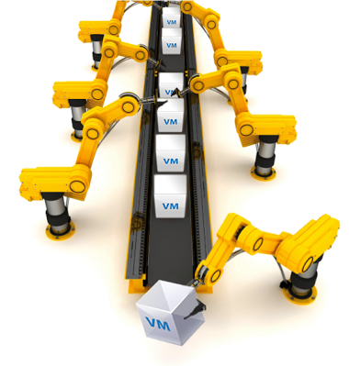
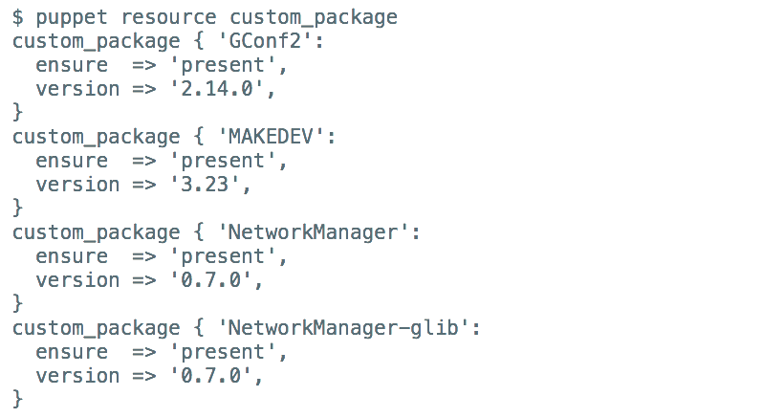
Dev-Ops: 2. Automation
Infrastructure = Code
Configuration = Code
Fast turnaround
Provisioning – add more of... Anything.
(#cloud)
Tools..
Jenkins/Ansible/Jira/Terraform... Many.
“Dockerize” – now K8s
Github ( :thumb )
Push-Button ...
Build (what about the design?)
Test (... rrrreally ????)
Deploy...
automatic
To error is human, but to really mess things up you need a computer…(Debug a tf file....!)
Biggest challenge: Autmatic Testing… (test is never complete, and you cannot test Q into a Prod)

Slide 20
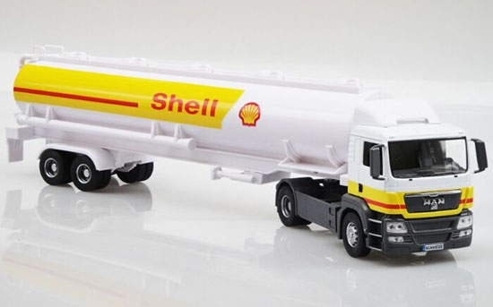


Dev-Ops: 3. Continuous
“Continuous” Delivery
Pipeline vs tanktruck
Pets vs Cattle (… vs swarm)
Automated + Permanent Testing..
QA = Challenge..
Good automated testing..
Tools..
Jenkins/Hudson (workflow + test..?)
Question: what is “current state” ?
And how to stop the flow... ?
Continuous … Allow for quick changes, permanent changes.. … (Test ? QA?)
Biggest challeng: Autmatic Testing… We are stilllearning these tricks...

Slide 21
Dev-Ops : Design…
BDUF
Supposedly …Bad..
Big Design Up Front…
Too rigid (?)
Without a “plan”, a Map…
No Idea where you are going..
I think: SDUF = probably needed..
Some Design Up Front…
Bduf is the new on-prem… BDUF = old, bad... But Without minimum Design… Chaos
Probably: Lightweiht “process” and Resonable Data-Model (Key Structure, Data-Life-Cycle (ILM), Archiving …

Slide 22

Dev-Ops : Knowledge, Skills…
Use of Concepts and Tools
Specialization: Supposedly …Bad..
Specialists don’t communicate well.
For “the hammer”, everything is a nail…
Without a Knowledge and “skills”
Clumsy stuff results.
I think: SKUF = probably needed..
Some Knowledge/Training Up Front…
Dev-Ops doesn’t favour “specialists”, but you need a minimum level of knowledge and skill to accomplish anything. Probably: Lightweiht knowlegea and some “experience” is needed.

Slide 23
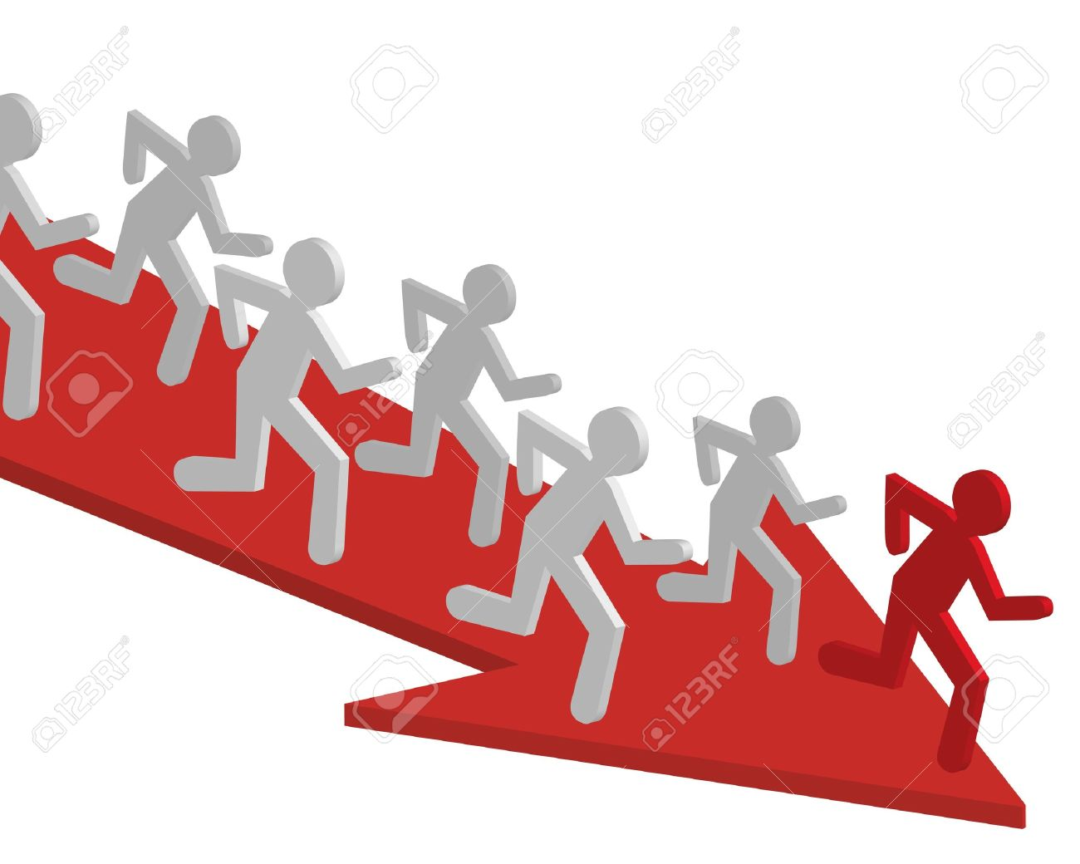
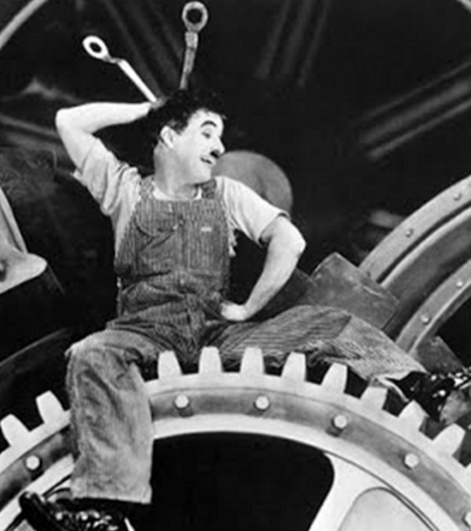
You. Will. Do. Dev-OPS…
…or DevOps will do You
Collaboration => Good!
Focus on Customer/goal.
Understanding + Education..
Eliminate Management layers..
Automation + Continuous => Good
Less human Error…
But also: Less Human Correction ..
And ... Needs Debugging (and test)
Image:
shiny
The positive sides : Keep them.. The potential problems: Try to fix.
Make sure teams had “knowing”, and make sure automation doesn’t control you..

Slide 24

Short : Be like him …
Be Flexible, helpful, communicative.
(but mind : Architecture, structure…)

Slide 25

Short : Avoid this…
Don’t become a slave… and Avoid bossy-bosses.
(mind: some Architecture, some structure, is needed)

Slide 26
Then: Create this…?
Regulation needed…
Architecture, structure…

Slide 27

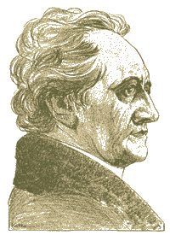
Don’t Take my word for it…
Homework: Check your Dev-Ops!
- Goal clear ?
- BDUF / SDUF … minimal design ?
- Skills … under control ?
- Silos … under control ?
- (managers … under control?)
Simple Oracle Dba . Blogspot . com (my ramblings)
And keep it Simple!
Goethe: Limitation shows the Master.
Firefox
literature
Majority of times, I have been WRONG.
So go see for yourself - but don’t complicate life. “In der Beschrankung zeight sich der Meister”

Slide 28


Quick Q & A (3 min ;-) 3 .. 2 .. 1 .. Zero
Questions ?
Reactions ?
Experiences from the audience ?
Best part of most meetings: Question and Answer time. Discuss.
Teach me something: Tell me where you do NOT AGREE.

Slide 29
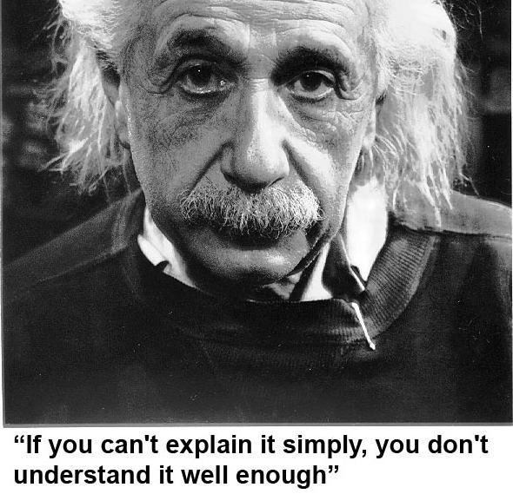
He got it …
As Simple as Possible, but not too simple
Simplicity is a Requirement - but Comlexity just sells better (EWD).

Slide 30
The very, very end…
Intentionally left blank

Slide 31
The very, very end…
This tech is still ahead of any pg-wal or barman, but oracle want too much…
#poug17 speaker:
let me exp… –hic- expllllllain.
(bad joke again)

Slide 32
Dev-Ops : Good !
The Collaboration => Good!
Focus on Customer/goal.
Understanding + Education..
Eliminate Management layers..
Eliminate “Hobbies”
Risk: loss of Knowledge (ACID)
Automation + Continuous => Good
Less human Error…
But also: Less Human Correction ..
And ... Needs Debugging (and test)
Image:
shiny
The positive sides : Keep them.. The potential problems: Try to fix.
Make sure teams had “knowing”, and make sure automation doesn’t control you..

